Slide 1
Advanced Machine Learning
Spring 2020

Slide 2
What we will cover
Understanding Deep Learning
Neural Networks
Deep Learning for Computer Vision
Convolution Networks
Recurrent Networks
Understanding Time Series
Regression-based Forecasting
Smoothing Methods

Slide 3
References
Data Mining for Business Analytics, Shmueli, Bruce, Yahev, Patel, Lichtendahl Jr., Wiley.
Deep Learning with R, François Chollet with J. J. Allaire, January 2018, ISBN 9781617295546
https://github.com/jjallaire/deep-learning-with-r-notebooks.git

Slide 4
What is Deep Learning?
Definitions of fundamental concepts
Machine learning development
Key factors behind deep learning popularity
Note: Figures and text copied from Deep Learning with R, François Chollet with J. J. Allaire, January 2018, ISBN 9781617295546

Slide 5
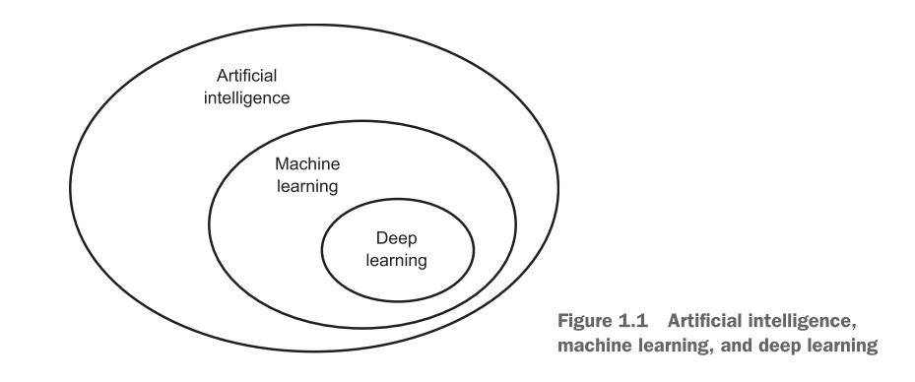
AI, ML, Deep Learning
1950; The effort to automate intellectual tasks
1840 - Analytical Engine; Turing Test
Notes:
Symbolic AI (1950-1980) - hardcode sufficiently large set of rules; Good for logical problems like Chess, but intractable for fuzzy problems like image classification, etc.
ML: “Can a computer go beyond “what we know how to order it to perform”

Slide 6
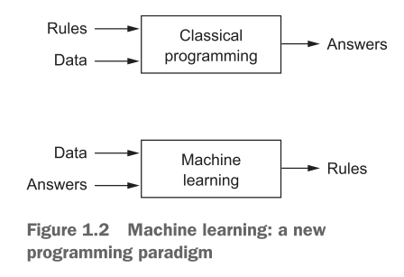
Machine Learning
Can a computer go beyond “what we know how to order it to perform?”
Notes:
Machine learning is tightly related to mathematical statistics, but it differs from statistics in several important ways. Unlike statistics, machine learning tends to deal with large, complex datasets (such as a dataset of millions of images, each consisting of tens of thousands of pixels) for which classical statistical analysis such as Bayesian analysis would be impractical. As a result, machine learning, and especially deep learning, exhibits comparatively little mathematical theory—maybe too little—and is engineering oriented. It’s a hands-on discipline in which ideas are proven empirically more often than theoretically.

Slide 7
Representations in ML
Specify input data
Provide examples of the expected output
Determine how to measure the performance of the algorithm
The central problem in ML (DL) is to meaningfully transform data; i.e., to learn useful representations of the input data
What is a representation?

Slide 8
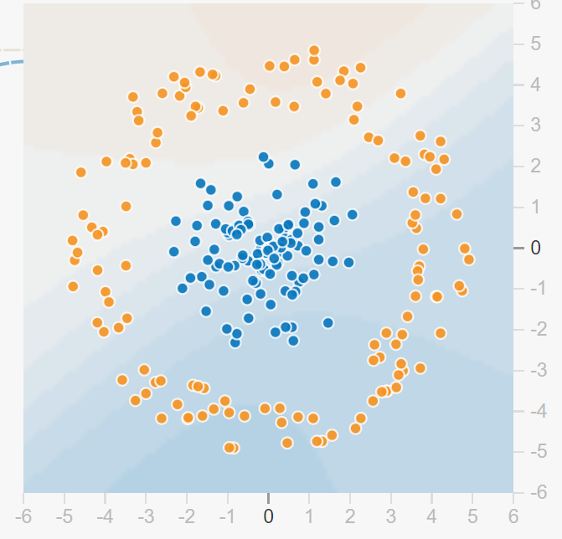
Example
Decide the color of a point based on (x,y)
Inputs are coordinates of our points
Outputs are the colors
Performance?
What representations can we consider?

Slide 9
Learning
Learning in machine learning describes an automatic search process for better representations. All machine-learning algorithms consist of automatically finding such transformations that turn data into more-useful representations for a given task.

Slide 10
Deep Learning
A subfield of ML
Emphasis on learning successive layers of increasingly meaningful representations
The number of layers that contribute to the model is the depth of the model. The deep in DL therefore refers to the successive layers of representations
Often involves hundreds of successive layers
Layered representations are often modeled using neural networks

Slide 11
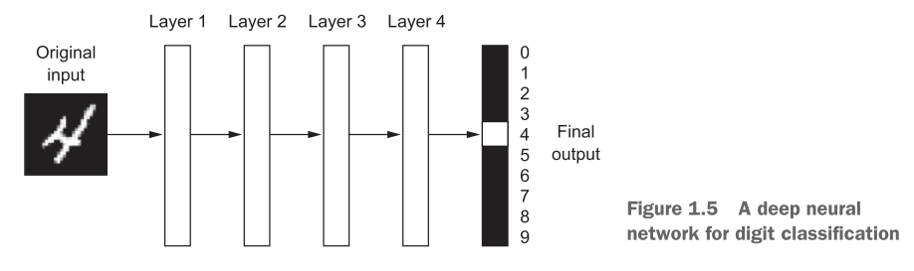
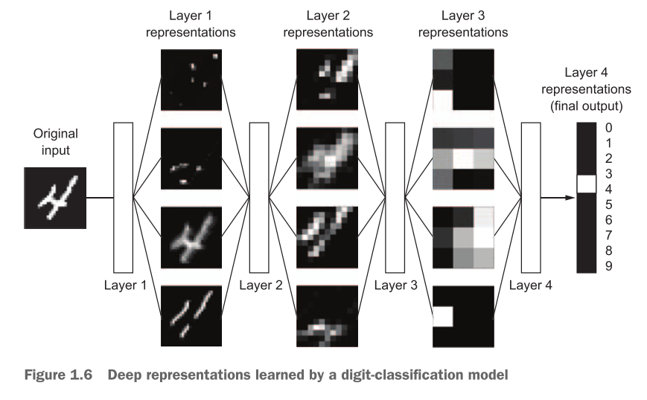
Example

Slide 12
How Deep Learning Works
Map Inputs to targets by observing examples of inputs and targets
Input-to-target mapping is done via a deep sequence of simple data transformations (layers) and that these data transformations are learned by exposure to examples
The specification of what a layer does to its input data is stored in the layer’s weights, which in essence are a bunch of numbers. These weights are the parameters of a layer
Learning thus means finding a set of values for these weights so that the input is correctly mapped to the targets. DL contains millions of these weights!

Slide 13
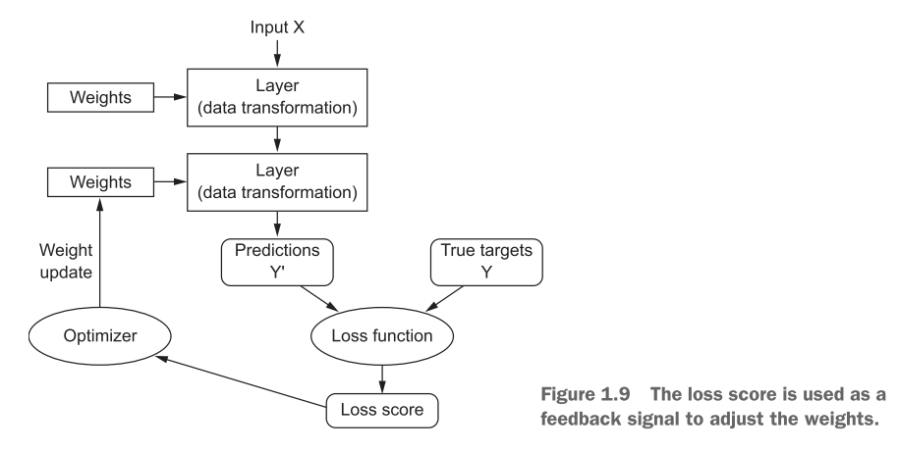
DL Process

Slide 14
DL - So Far
Near-human-level image classification, speech recognition, and handwriting transcription
Improved machine translation
Improved text-to-speech conversion
Digital assistants such as Google Now and Amazon Alexa
Near-human-level autonomous driving
Improved ad targeting, as used by Google, Baidu, and Bing
Improved search results on the web
Ability to answer natural-language questions
Superhuman Go playing

Slide 15
ML History
Probabilistic Modeling: Naive Bayes, Logistic Regression
ANN: Backpropagation
Kernel Methods: Support Vector Machines
Hard to scale; shallow method; have to do feature engineering
Decision trees, random forests, and gradient boosting machines
RF are generally the second-best method for shallow learning tasks
GBM are usually one of the best methods for non-perceptual data

Slide 16
Why is DL different?
Better performance
Automates feature engineering (why can’t we do this with successive shallow models?)
learns all layers of representation jointly
the incremental, layer-by-layer way in which increasingly complex representations are developed

Slide 17
Why DL now?
It is an “engineering science.”
Hardware
GPUs
TPUs
Datasets and benchmarks
Internet
IoT
Algorithmic advances
Better activation functions
Weight initialization schemes
Optimization schemes
Gradient propagation: Batch normalization, residual connections, etc.

Slide 18
Will it Last?
Simplicity
Scalability
Versatility and reusability

